Slide 1

ABAP integration – a recent case study
Graham Robinson
Yelcho Systems Consulting

Slide 2




Introduction
@grahamrobbo
*Photo by Martin Gillet

Slide 3
Agenda
Enterprise Content Management
Customer #1
Customer #2
Project #1 – Early Archiving of Invoices
Project #2 – Late Archiving of Invoices
Project #3 – Extranet
Lessons learned

Slide 4
Enterprise Content Management
Documents are unstructured content
Business transactions are structured content and contextual
ECM solutions can link unstructured to structured – thereby providing context to unstructured content e.g. Linking quotation documents to purchase requisition

Slide 5
SAP ArchiveLink
SAP’s service that provides a standard way to store/retrieve documents to/from 3rd party storage repositories (archives) whilst maintaining business context
OpenText is a leader in partnering with SAP
But potentially any document repository can support SAP ArchiveLink
There are lots that already do

Slide 6
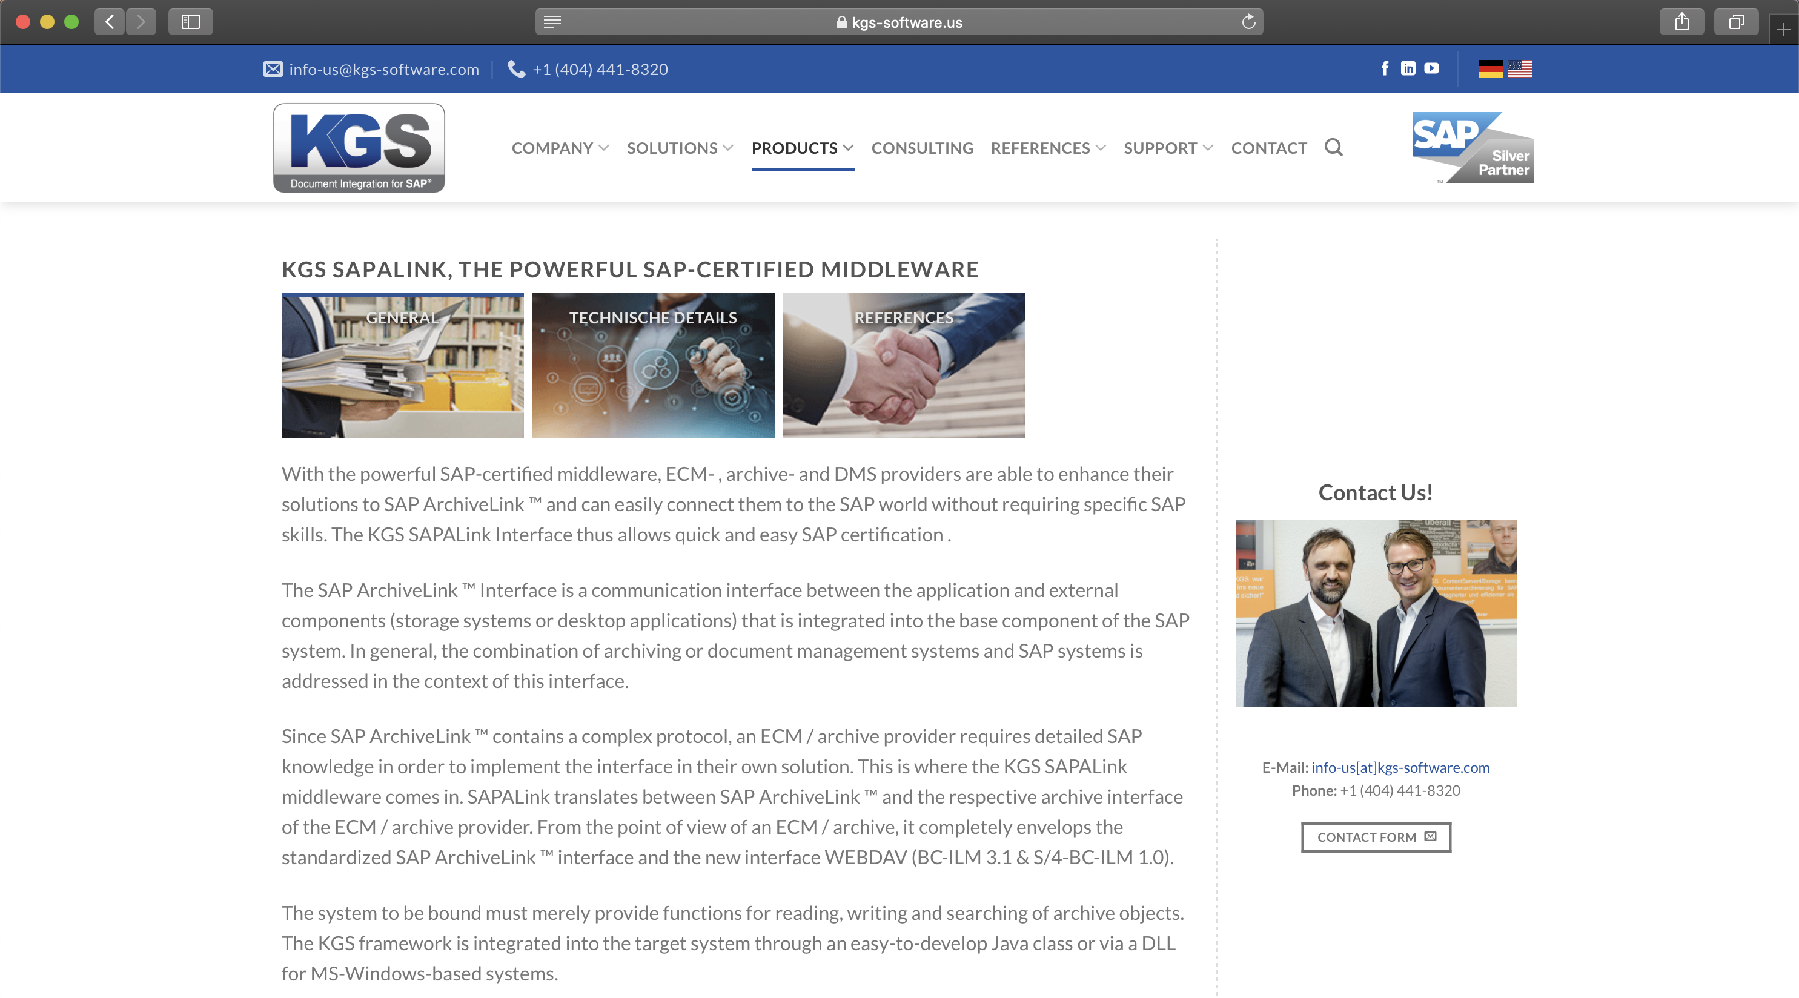

Slide 7
KGS

Slide 8
M-Files
Founded in Finland
Local reseller/SI is Upstream

Slide 9
M-Files Concepts
Objects, documents, metadata, relationships, etc.
Configuration
Workflow
VBScript handlers

Slide 10
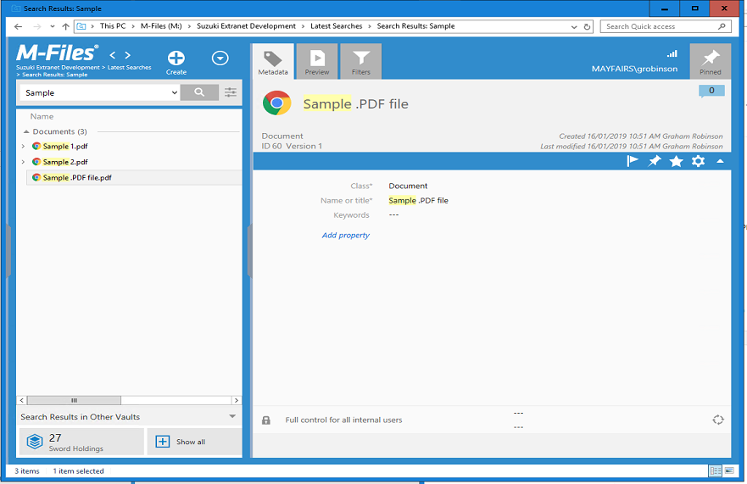

Slide 11
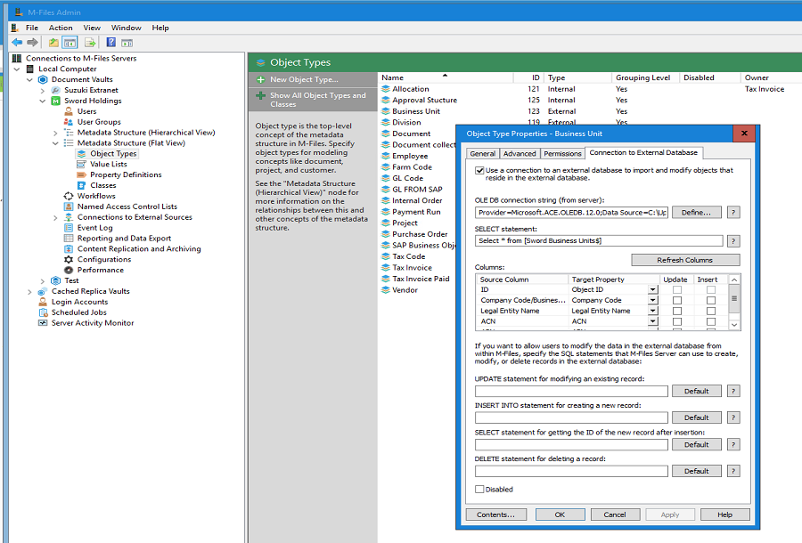

Slide 12
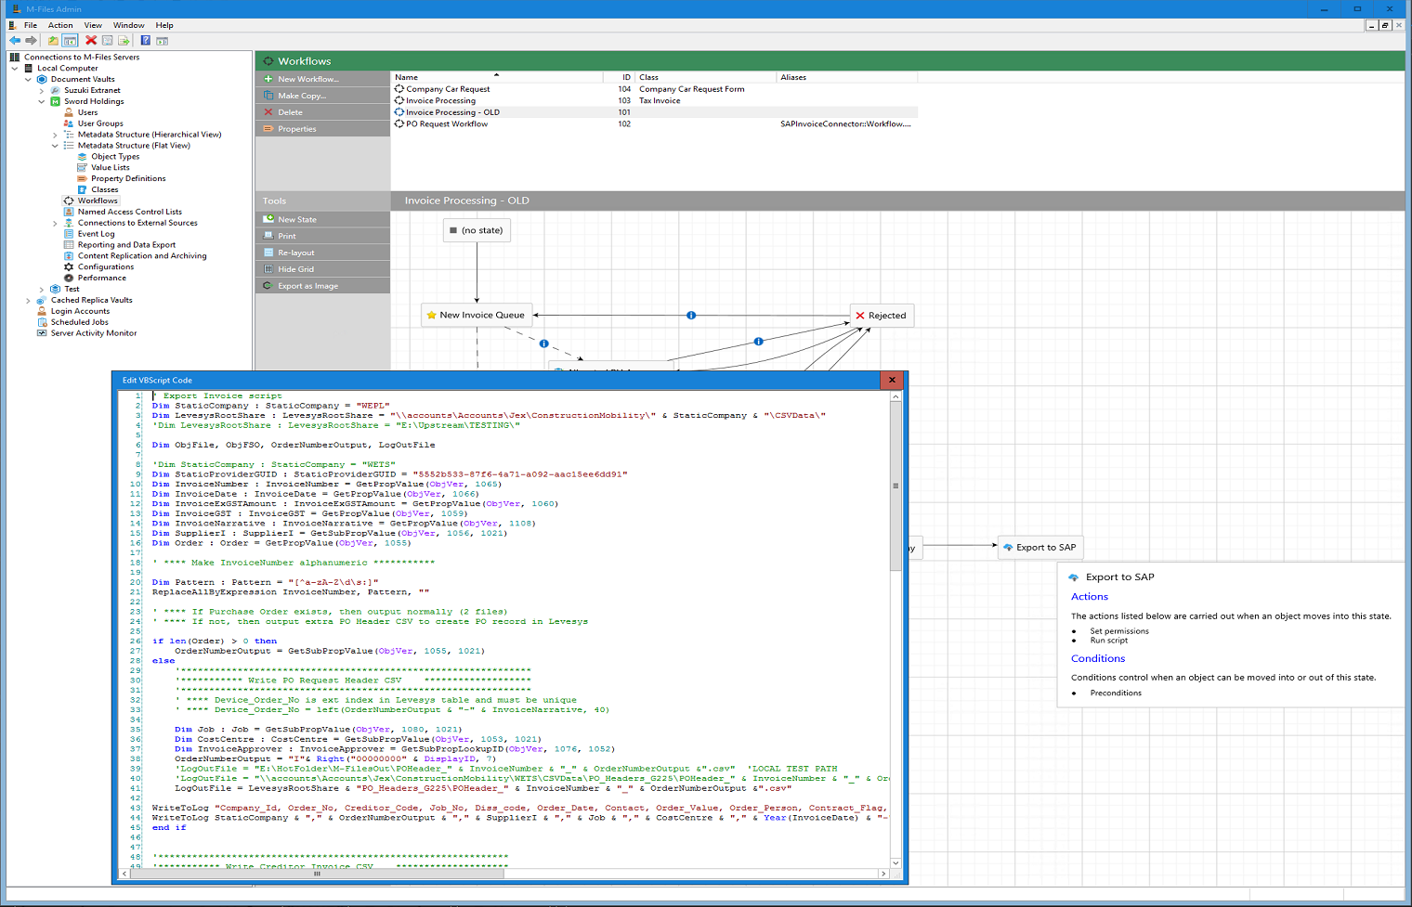

Slide 13
Customer #1
Automotive Industry
Existing relationship via Fuji Xerox
Was chosen as Content Management/Document Management solution across organisation
SAP ArchiveLink feature not licensed
Built ABAP client for M-Files Web Service (REST API)

Slide 14
Customer #2 – Sword Holdings Group
Automotive Industry
Looking for ECM solution but not wanting to pay “SAP tax”
M-Files chosen in part because of my previous experience with it and the ABAP client that had already been built
SAP ArchiveLink included in license

Slide 15
Project #1
Early Archiving of Vendor Invoices
SI led project
Scan/OCR invoice and store in M-Files repository
M-Files workflow to complete invoice details. E.g. account assignments, approvals, etc.
Post Invoice to SAP
Record SAP Invoice details in M-Files

Slide 16
Project #1
Original design was for bi-directional bulk flat file transfers
Other suggestions included making web service calls, OLE DB database access, etc.
….
Dominion post (Newspaper). Fletcher, David 1952- :"As you know all intelligence matters are on a 'need to know' basis ..." 22 July 2011. Ref: DCDL-0018382. Alexander Turnbull Library, Wellington, New Zealand.

Slide 17
And then a miracle happened….
Mikko Roihuvuo
Developer Evangelist

Slide 18
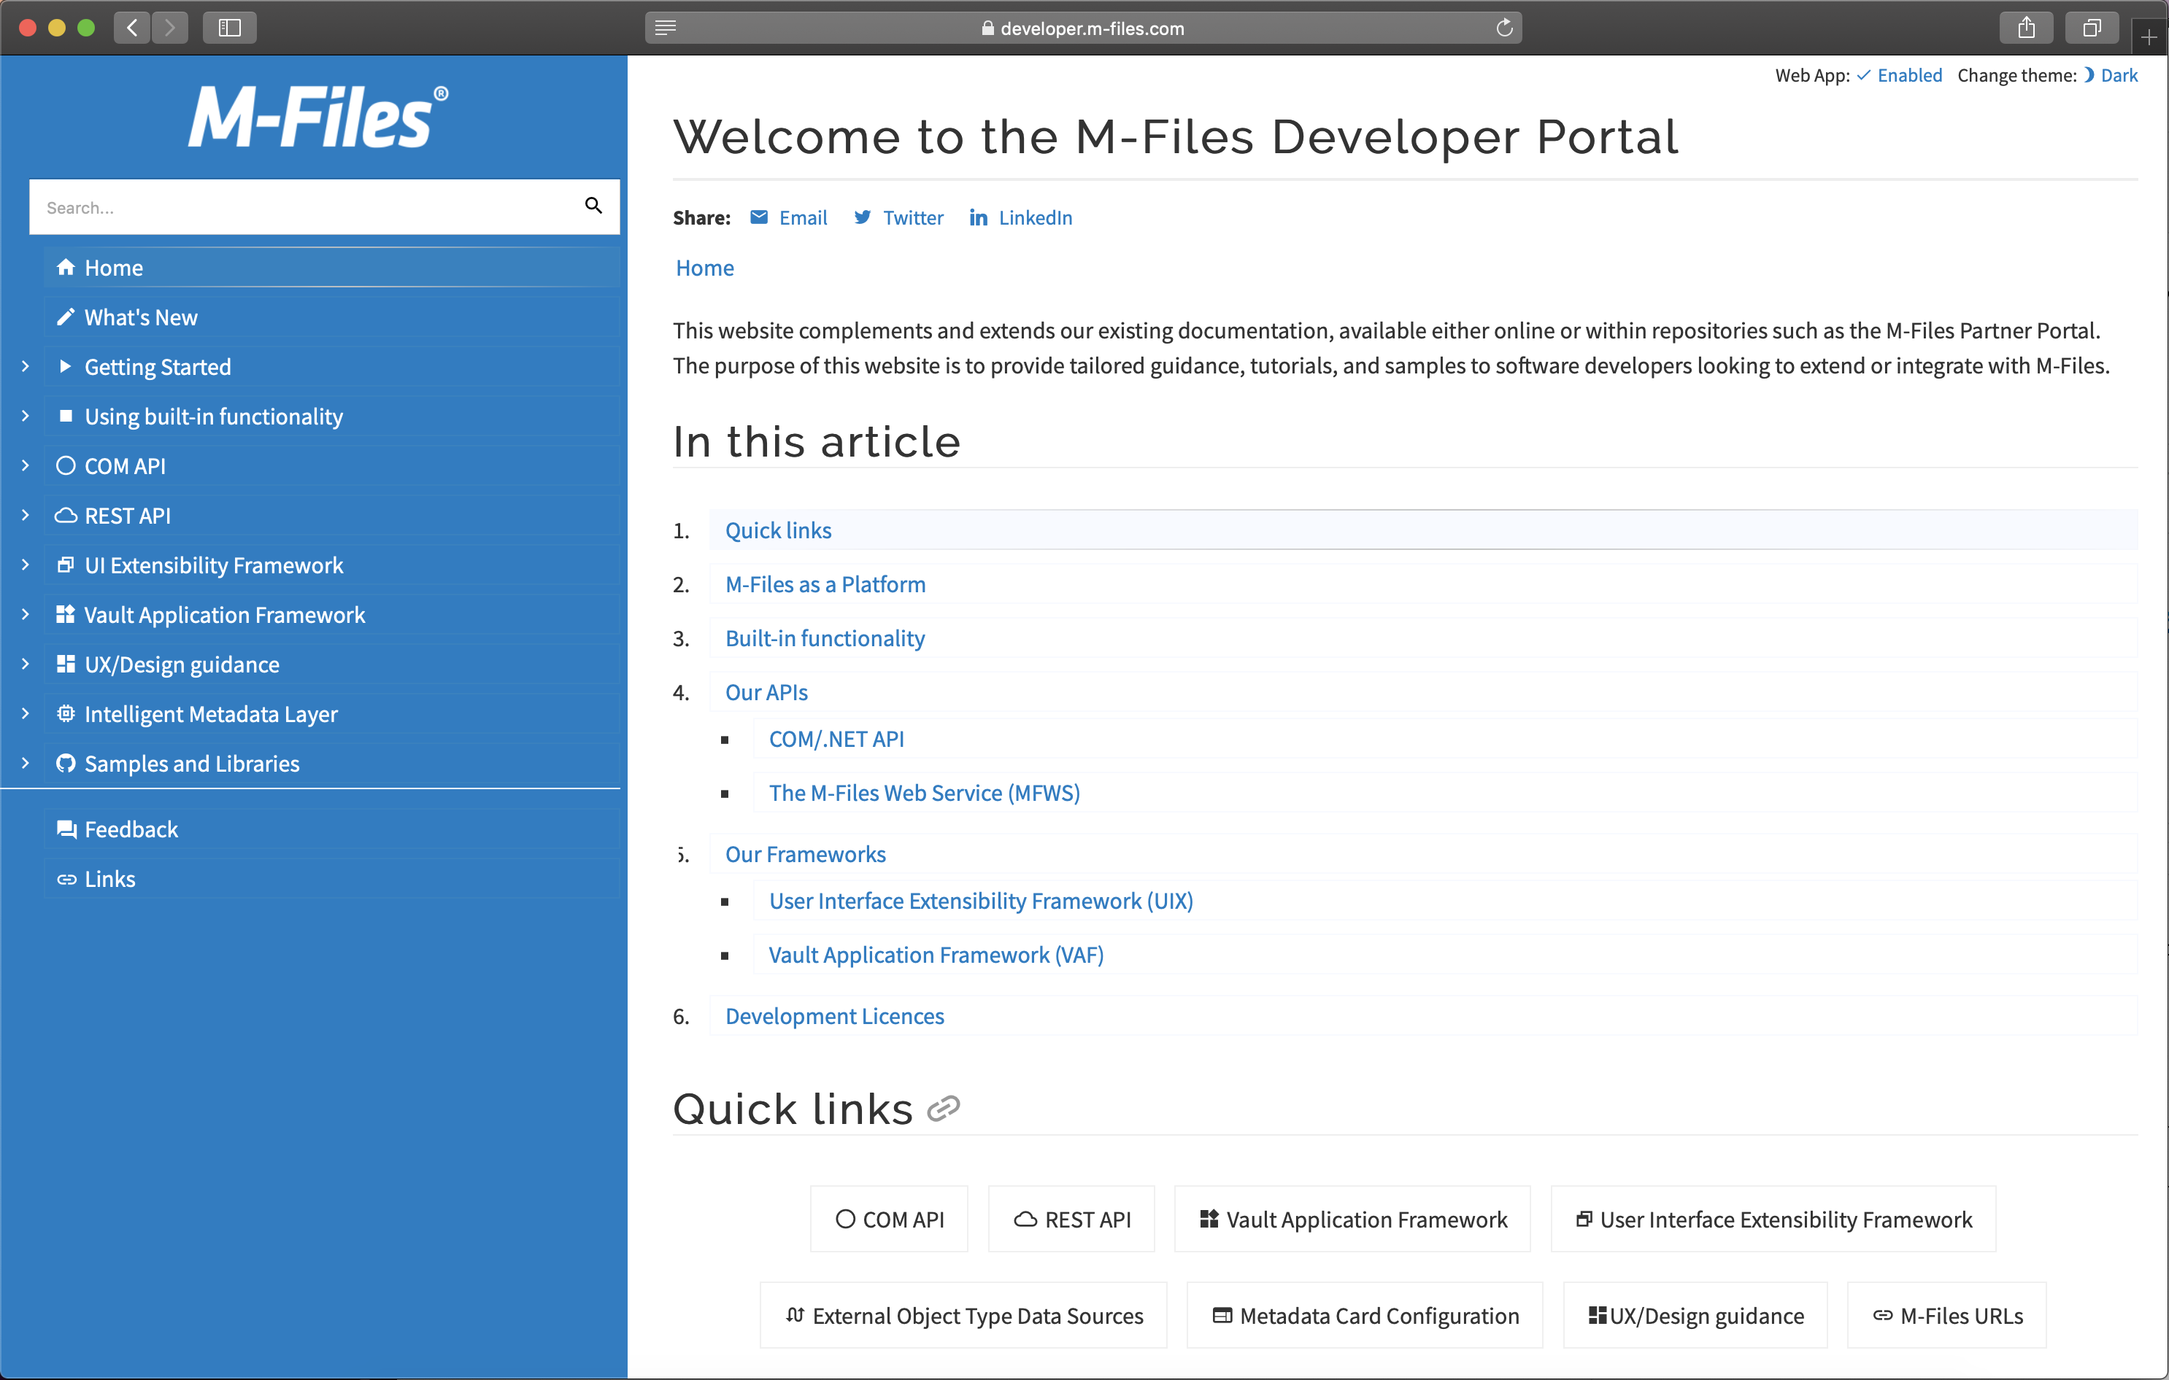

Slide 19
Vault Application Framework
Strongly Typed
Reduction in code – and much much faster code too
Helper utilities
Utilisation of .NET Framework Class Library, and other .NET libraries
E.g. SAP .Net Connector
Better development environment
Building
Debugging
Deploying

Slide 20
There is a better way…

Slide 21
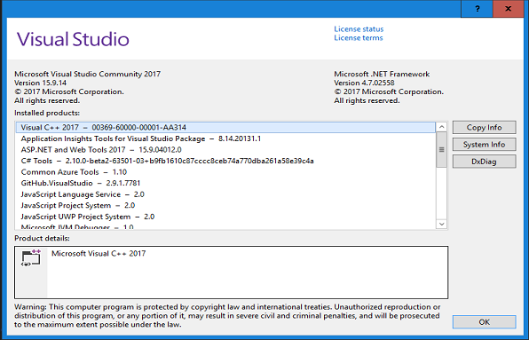

Slide 22
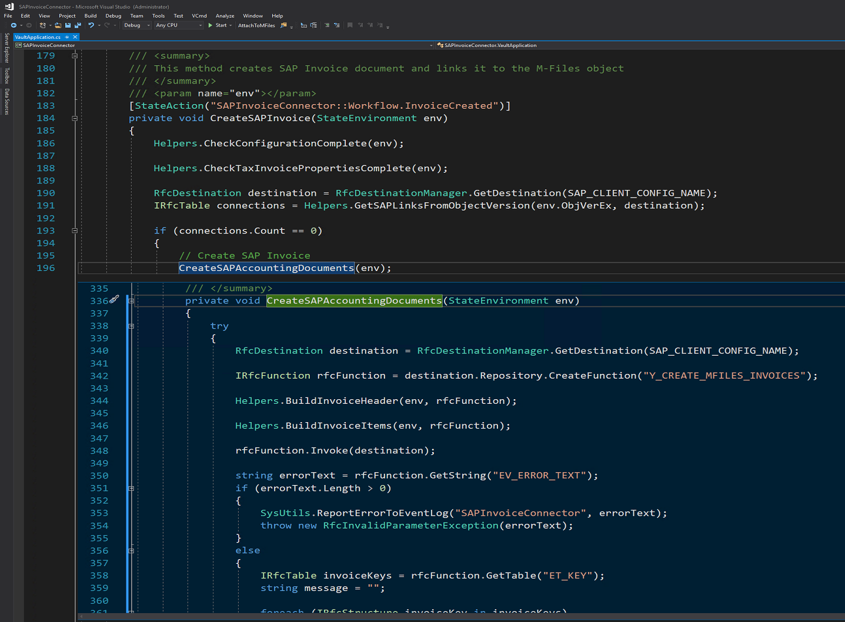

Slide 24
Project #1
Any reversals are done in SAP system
Business Transaction Event* triggers code to make necessary changes to M-Files metadata
* Business Transaction Event FI-AP-AP 00001030 POST DOCUMENT:Posting of standard data

Slide 25
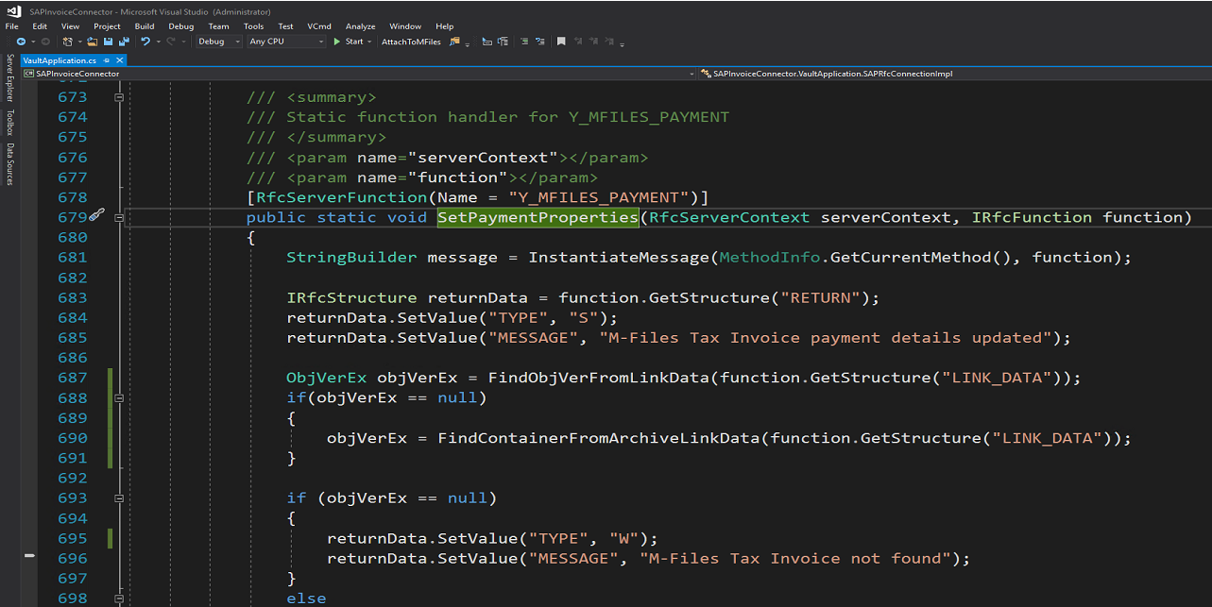
Project #1.1
Post payment details back into M-Files

Slide 26
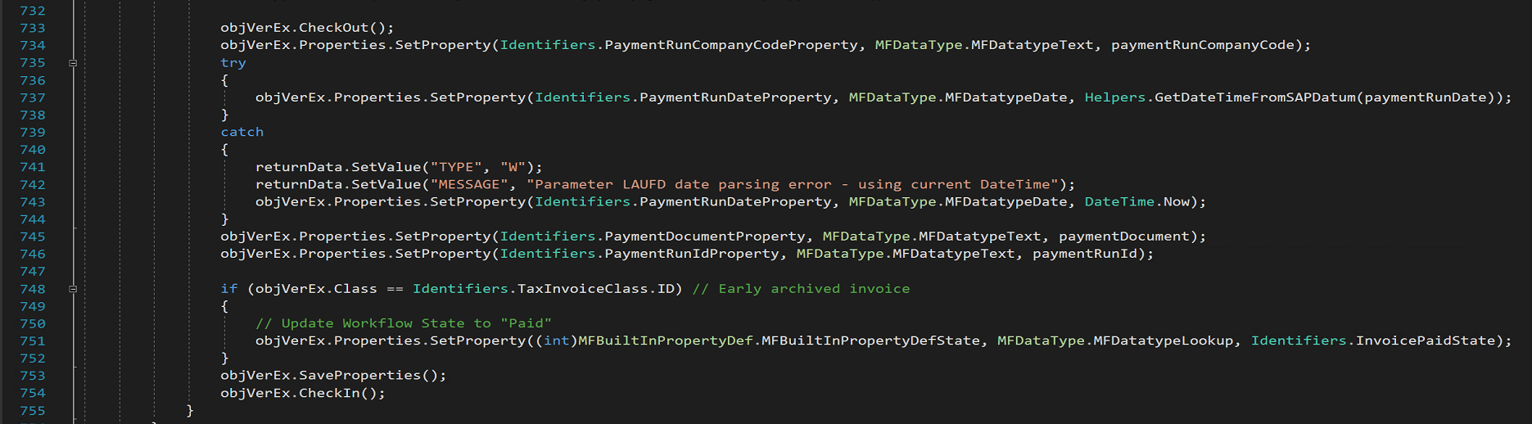
Project #1.1
Post payment details back into M-Files

Slide 27
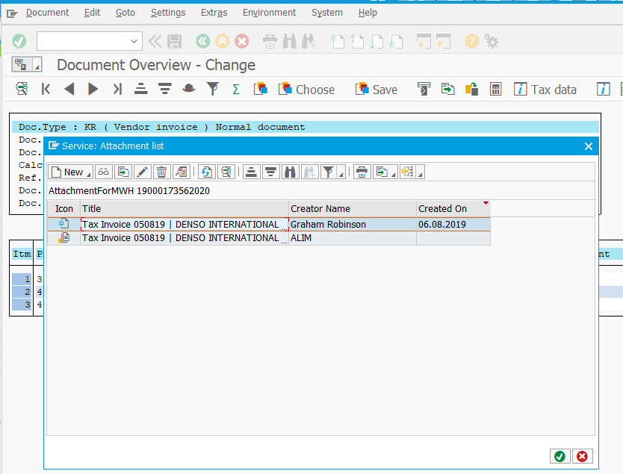
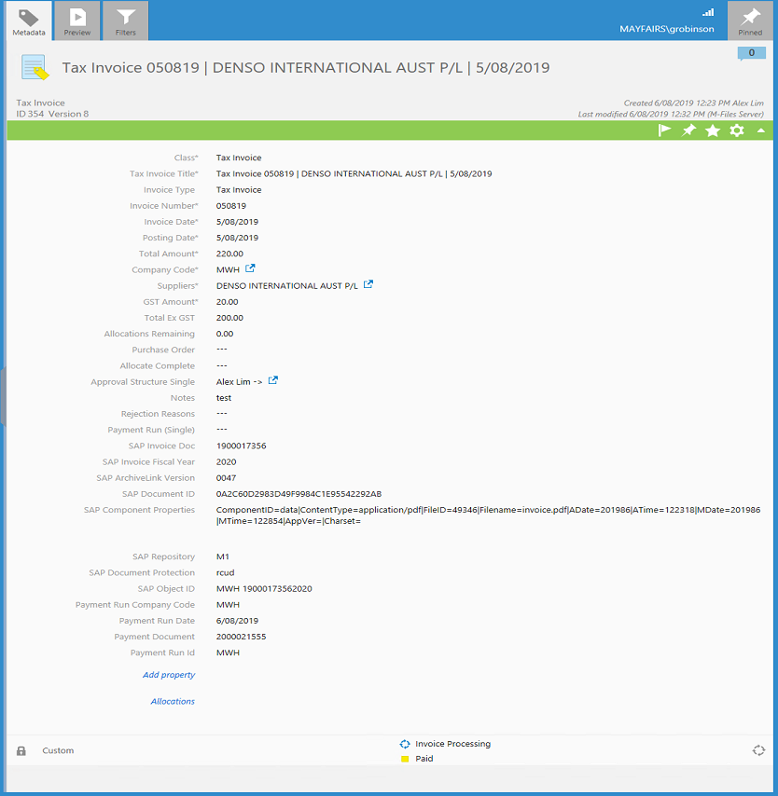
Project #1.2
Use SAP ArchiveLink to connect SAP Invoice to M-Files source document

Slide 28
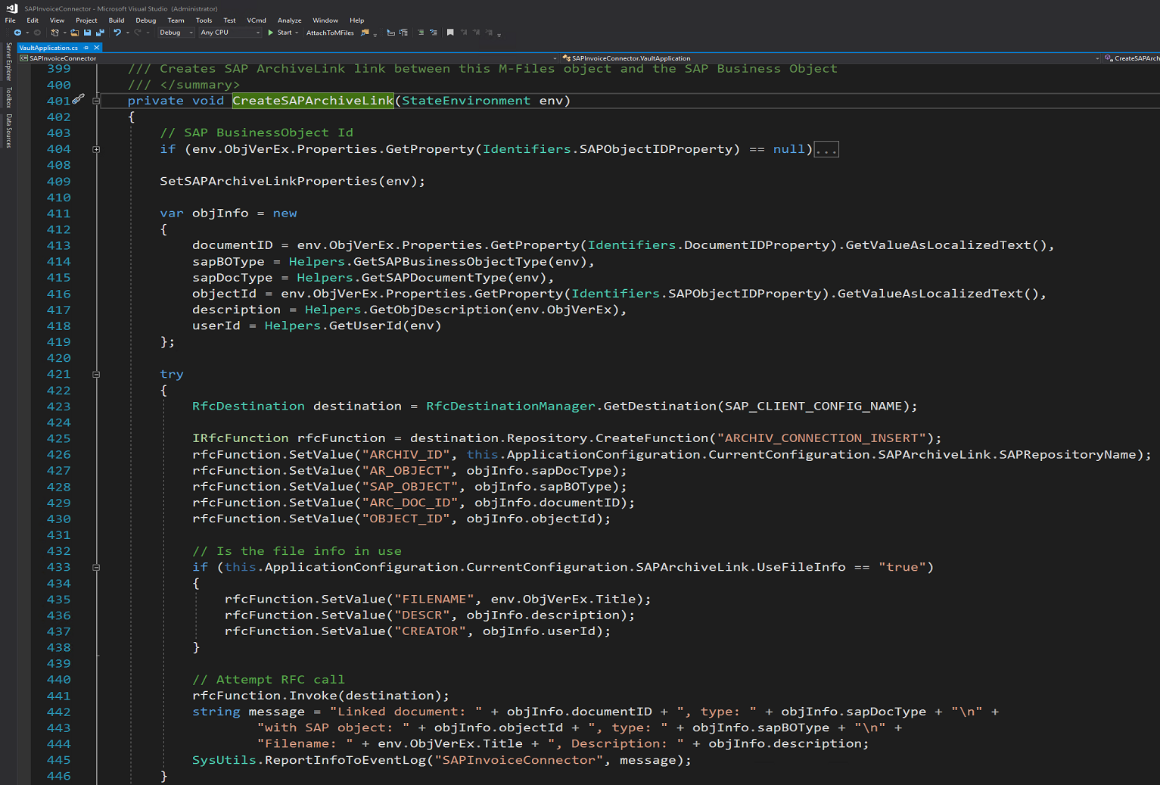
Project #1.2

Slide 29
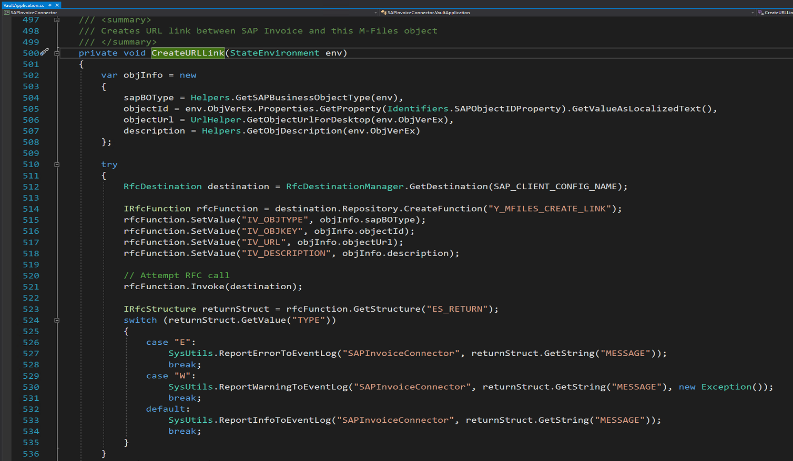

Slide 30
Project #1.2
Use SAP ArchiveLink to connect SAP Invoice to M-Files source document

Slide 31
Project #2
Late Archiving of Invoices
Query Invoice & Payment Details within M-Files
Use standard SAP ArchiveLink interface
SAP BADI OA_BADI_LINK
SAP BO Container Concept

Slide 32
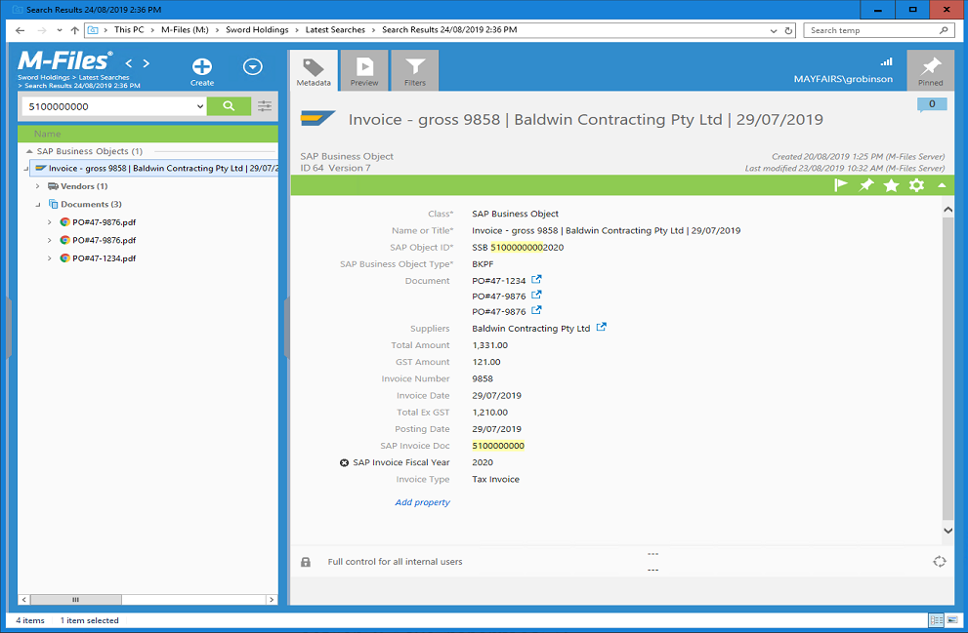

Slide 33
Project #3 - Extranet
Documentation
Bulletins
Recall Details
Training Videos
Sales Collateral
Software Updates
Etc.

Slide 34
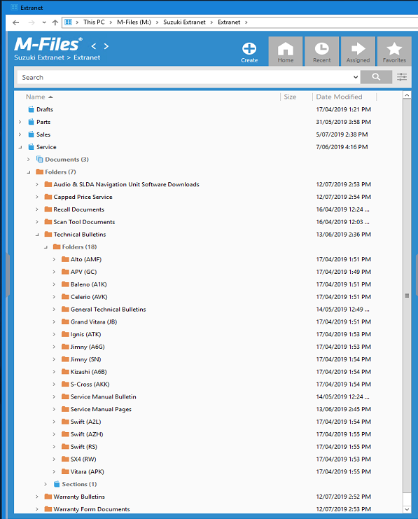
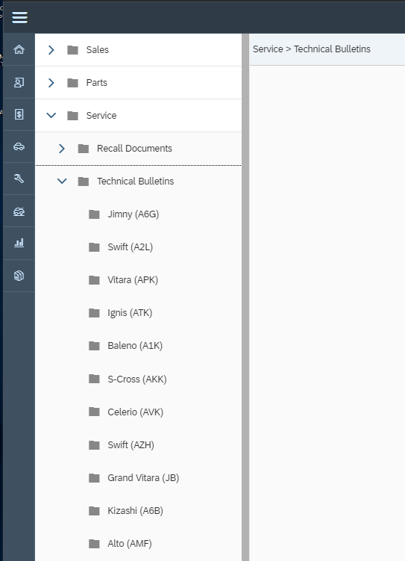

Sections
Folders
Documents
ABAP REST Handler
Cached on SAP server

Slide 35
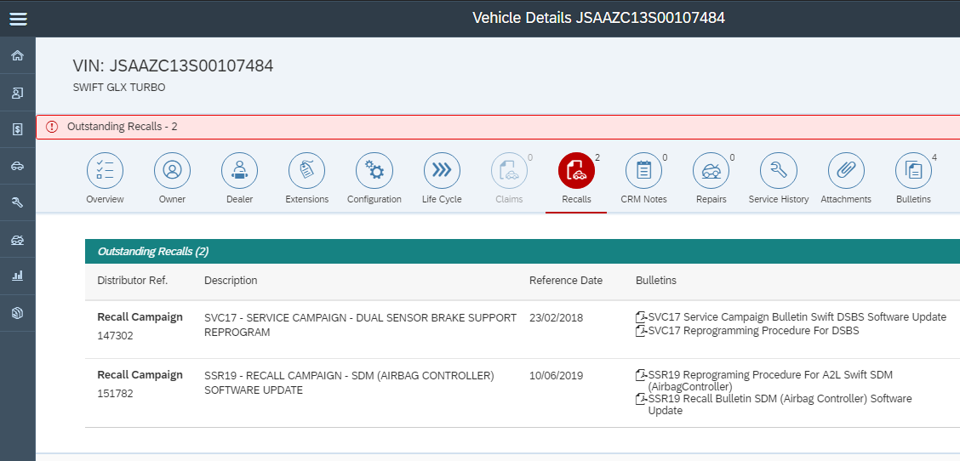
Contextual Documents
Vehicle Bulletins
Recall Bulletins
Etc.

Slide 36
Lessons Learned

Slide 37
Lessons Learned
Keep it simple, when you get too complex you forget the obvious.
Al McGuire

Slide 38
Lessons Learned

Slide 39
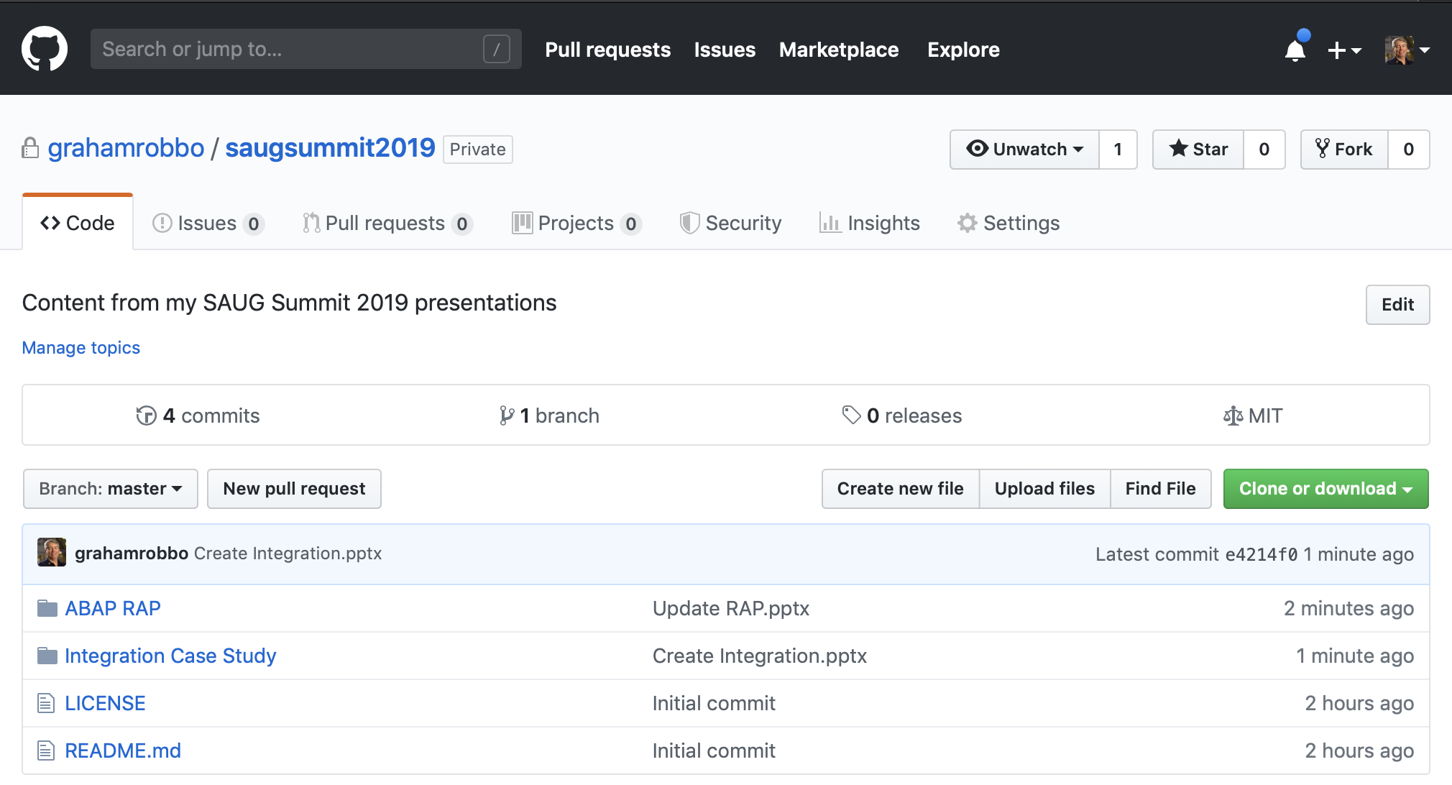

Slide 40
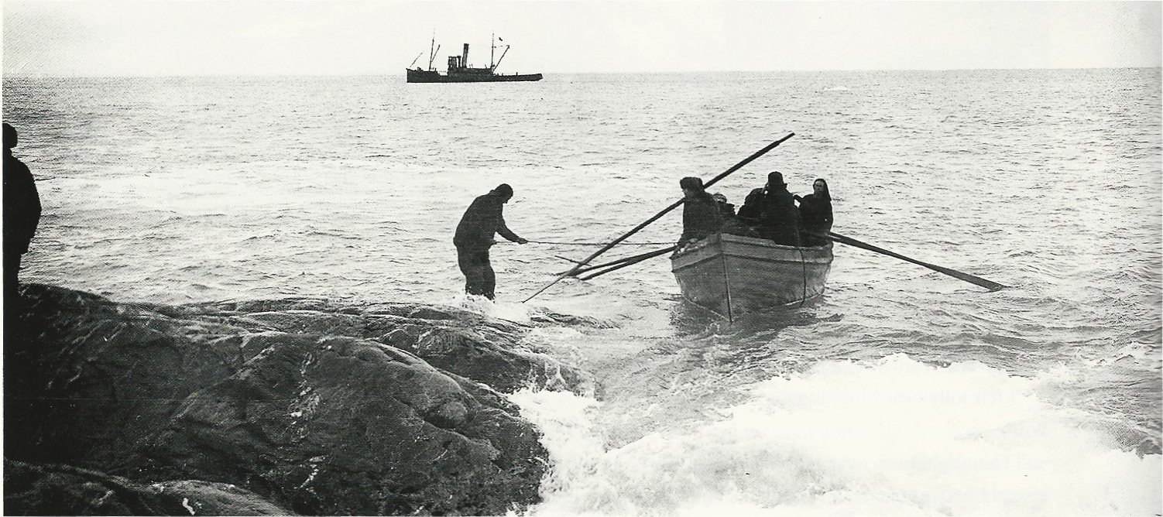


@grahamrobbo

